Slide 1


Slide 2
a New New Zealand :
Demographic transformation changes Aotearoa new zealand
Paul Spoonley
Distinguished Professor Emeritus
Cambridge U3A
February 2024

Slide 3
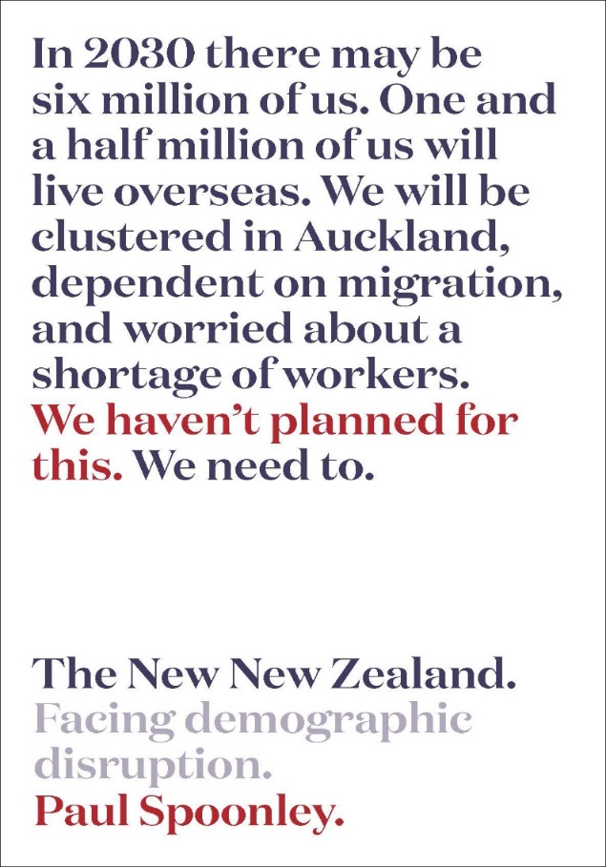

Slide 4
Demographic transformation and disruption – Aotearoa/New Zealand

Slide 5
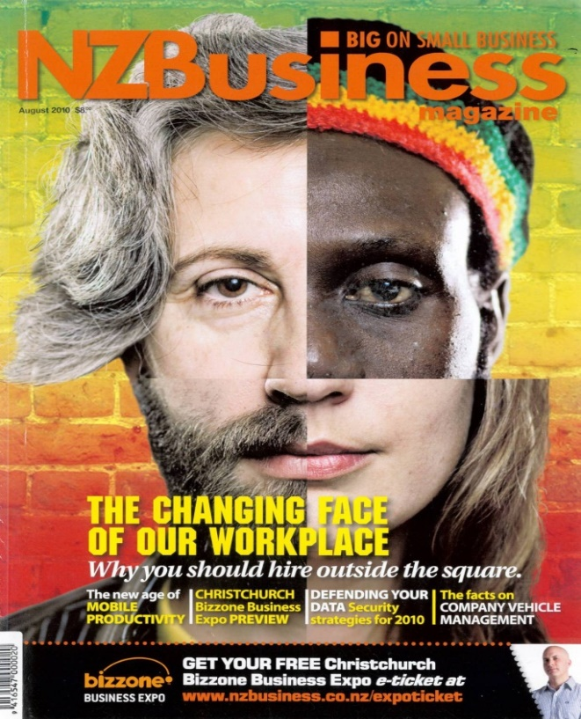
Demographic transformation – new zealand
Ageing population and declining fertility (doubling of 65+, sub-replacement fertility)
Ongoing urbanisation – with concentration in top of the North Island (Auckland effect - 40% of population by 2038)
Regional population stagnation/decline
(many TAs will see the end of population growth)
Immigrant-led diversity (rapidly growing diversity plus Māori-led economic and cultural development)

Slide 6
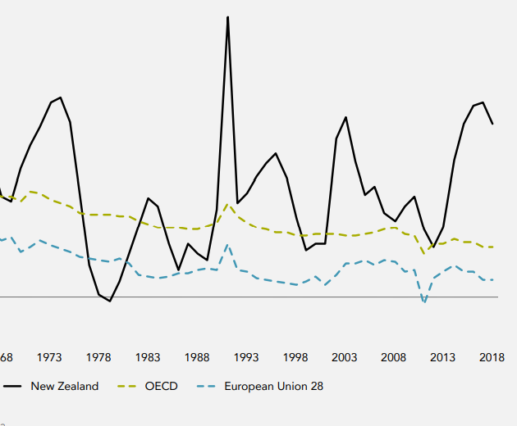
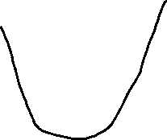
Population – annual growth rate (March 2023)
1
2
3
4

Slide 7
An ageing population

Slide 8
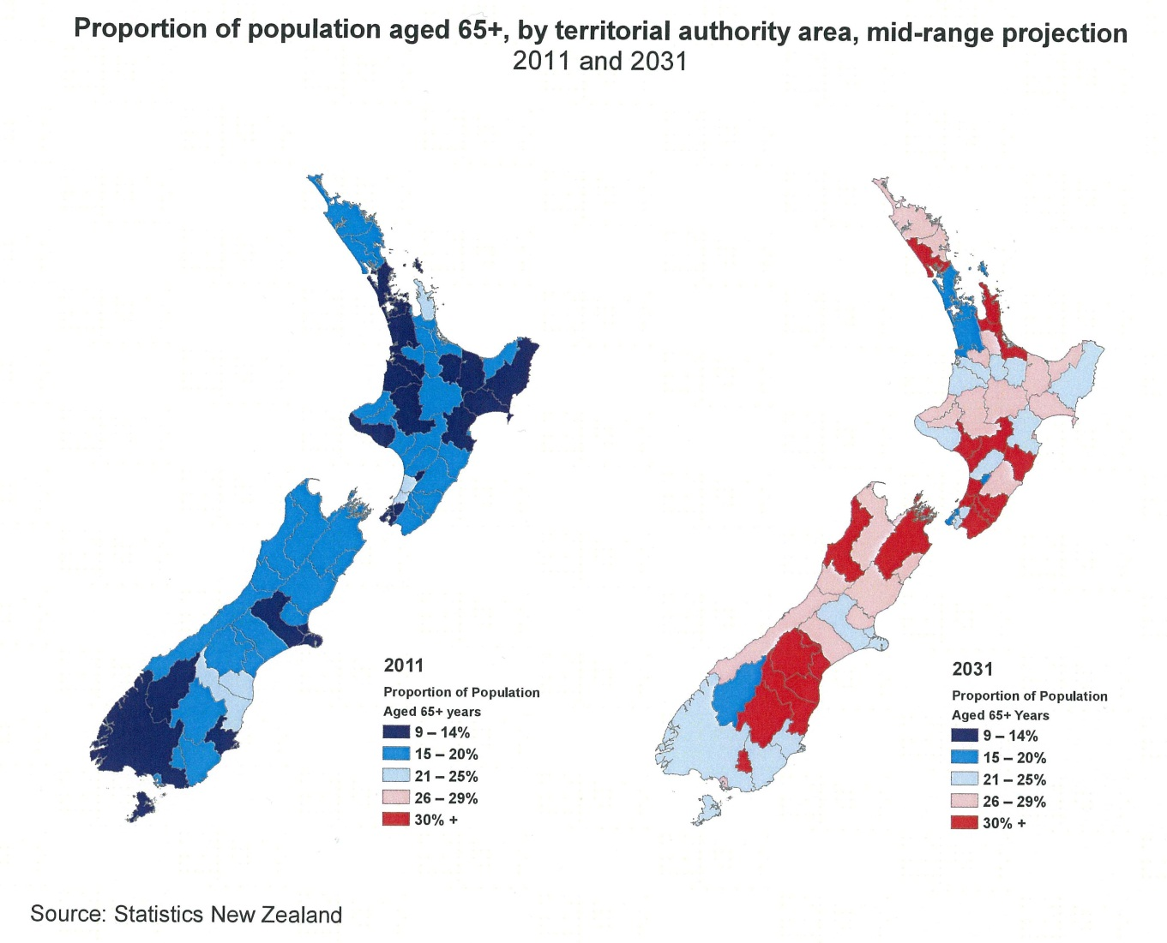
An Ageing population – and workforce
Proportion of population aged 65+, by territorial authority area, mid-range projection 2031
Source: Statistics New Zealand

Slide 9
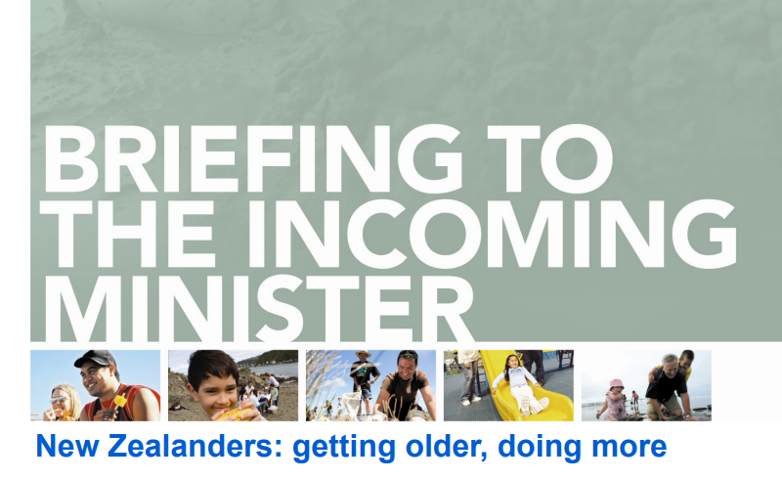
pĀkehĀ – ageing and wealthy
Bruce – 70 years old, lives in Thames
1.3 million aged over 65 (nearly 25% of total population) and 222,000 aged over 85
Lives in a hyper-aged town (nearly 50% aged over 65)
Owns his own house plus two rental properties (net worth of 65+ in 2021 was $433,000)
Living much longer (23.4 years from the age of 65, was 14 years in 1956)

Slide 10
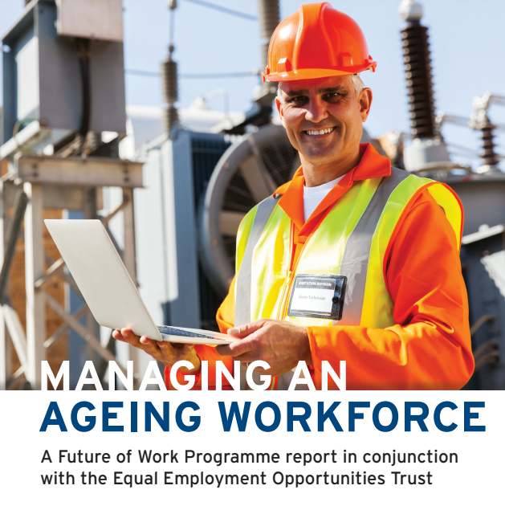
pĀkehĀ – ageing and wealthy
Bruce – 70 years old, lives in Thames
Still in paid work – over 65 year olds now 12% (300,000) of workforce and a quarter remain in paid employment past 65
Big spenders (airline tickets, holidays, cruises) with low debt levels and savings
Superannuation now costs about $36 billion per year and 25% of core government spending
Politically active but conservative

Slide 11
Declining fertility

Slide 12

Sub-replacement fertility Low, Low Fertility Country?
1950s high (4.3 births per woman), hit sub-replacement rate in 2017 (1.6)
Delayed births plus none/”one and done” (Millennials)
Higher educational qualifications + jobs + cost of raising children alongside other costs such as housing
By 2030, 30,000 fewer school students in Aotearoa/New Zealand

Slide 13
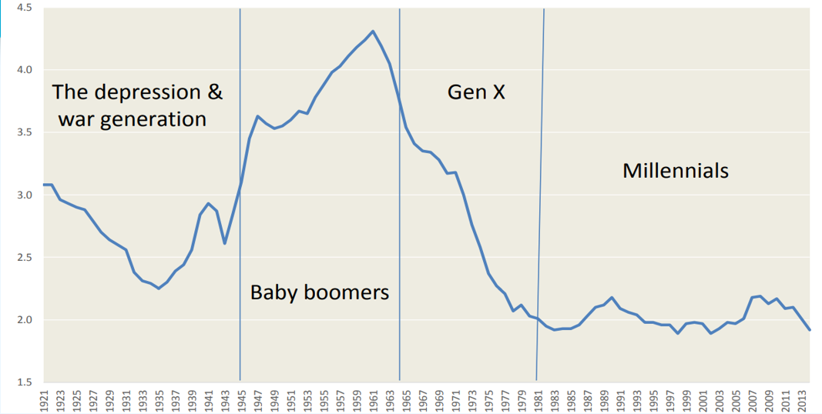
pākehā – Millenials and Gen z

Slide 14

pākehā – millenials and gen z
Louise – 42, lives in Wellington
Millennials, 1.2 million, Gen Z, 1.134 million
Has a partner but does not own a property. Still paying off student debt. Living in beanpole family household
Has chosen not to have children (more children are born to women aged over 40 than to women 20 and under)

Slide 15
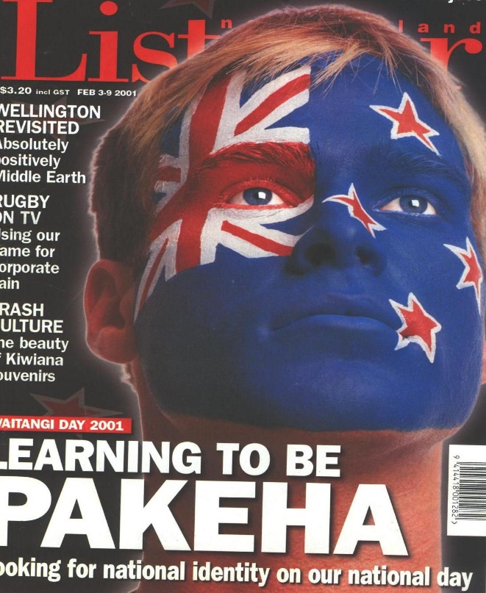
pākehā – millenials and gen z
Louise – 42, lives in Wellington
Spent 8 years at university (5-8 years on average)
Got first job – at a call centre – when 26 and did not get current job (government department) until mid-thirties
Entered labour market during Covid pandemic – labour market scarring
Environment a [the] major concern and frustrated at slow progress in 2020s.

Slide 16
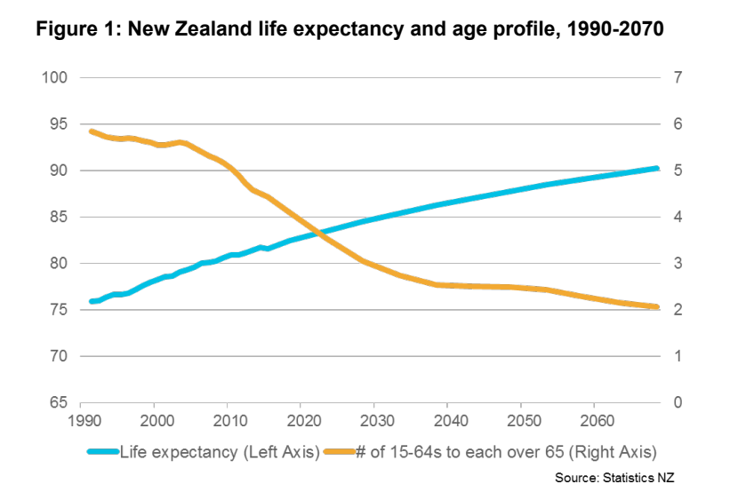

Ageing and a declining dependency ratio

Slide 17
Very different regional growth – and decline - stories

Slide 18
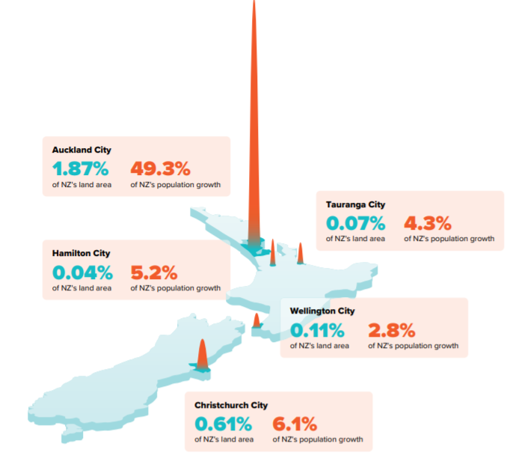
Growth centres in New Zealand over 2 decades

Slide 19
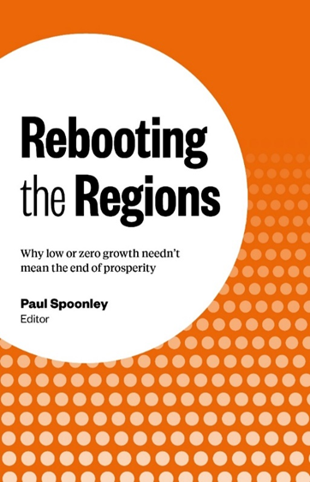
Ongoing urbanisation & regional stagnation
Two-thirds of regions in Aotearoa/New Zealand will experience ageing plus population stagnation or decline
Main regional towns will grow – Tauranga, Katikati, Cambridge – but surrounding smaller towns and rural areas will stagnate – and some will see depopulation and ageing
Population growth will be focused on top half of North island (40% will be Auckland residents)
Ongoing school closures in many regions

Slide 20
Immigrant-led diversity

Slide 21

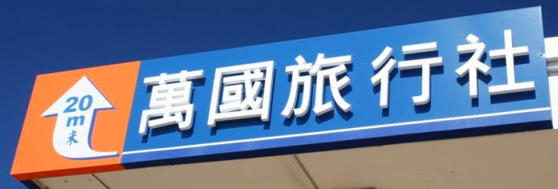
Immigration 2023
Permanent and long-term and temporary arrivals (September 2023)
Net Gain/Loss | +118,200
Arrivals | +237,200
Non-NZ Citizens | +163,600
NZ Citizens | -44,700

Slide 22
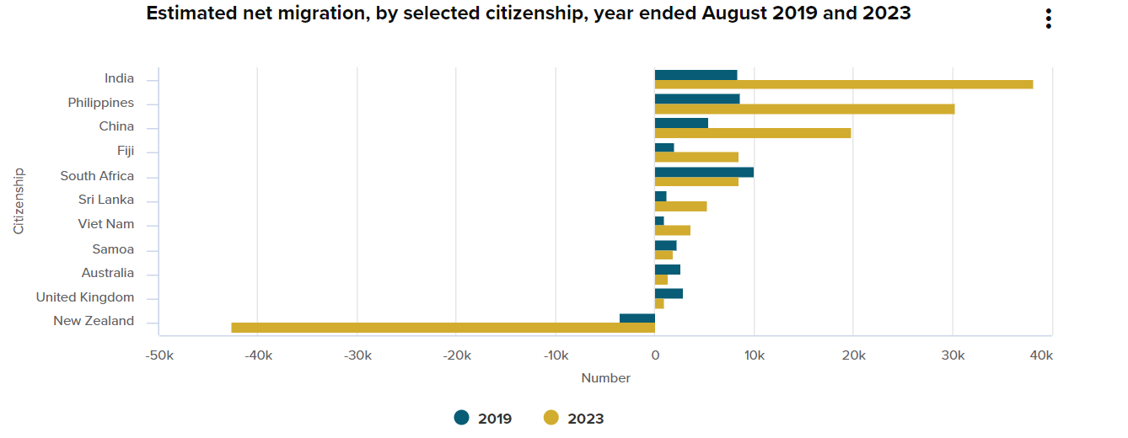
Immigration transforms aotearoa

Slide 23
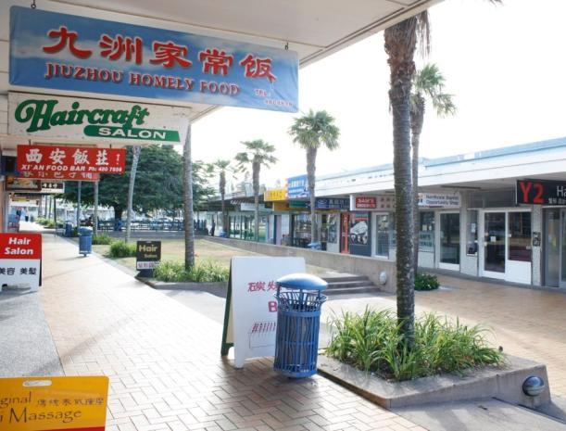
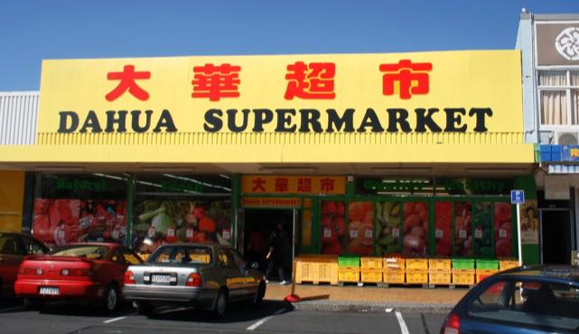
Superdiversity in Auckland (2023)
43% overseas-born or 600,000 people (56% are either immigrants or the children of immigrants)
23% identified as members of Asian communities (38-40% by 2038), 75% were immigrants
44% workforce overseas-born

Slide 24
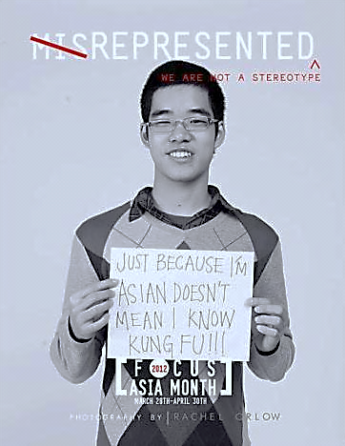
Chinese – a superdiverse aotearoa
Lily – 33 years old, lives on the North Shore
Born in China but is 1.5 generation
Member of one of the dominant Asian communities who now make up 25% of New Zealand’s population, and 38% of Auckland’s
31% of the NZ prime working age population are from one of the Asian communities
In 2030s, Asians 7% of 65+ population, Pākehā 75%

Slide 25
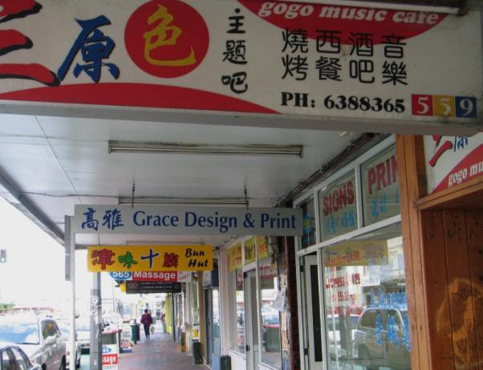
Chinese – a superdiverse aotearoa
Lily – 33 years old, lives on the North Shore
Plays table tennis (114,000 in Auckland while 59,280 played rugby in 2019)
Does not watch, listen to and read any mainstream New Zealand media but is very active on social media
Visits Beijing 2-3 times per year but has never visited Hamilton

Slide 26
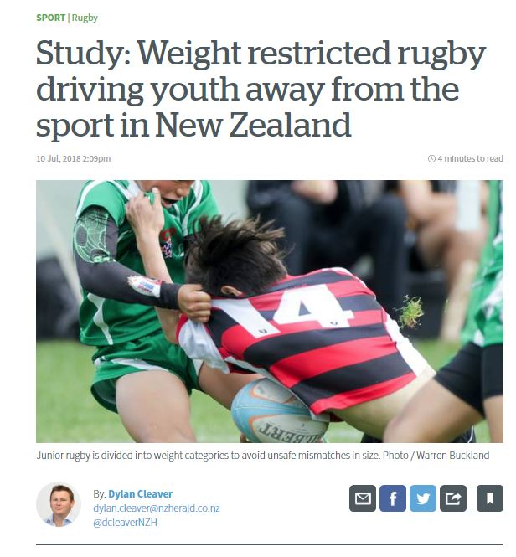
Superdiversity and Sports in Auckland
Some sports are going to struggle
Education is the priority
No prior engagement/understanding
Physicality
Males 2021 | Females 2021
1. Swimming (#5) 2. Golf (#10) 3. Football (#12) 4. Table tennis (#16) 5. Basketball (#17) 6. Tennis (#18) 7. Cricket (#20) | 1. Swimming (#5) 2. Road cycling (#12) 3. Table tennis (#16) 4. Tennis (#17) 5. Netball (#18)

Slide 27
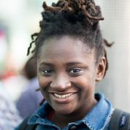
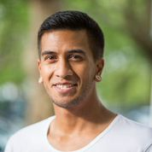



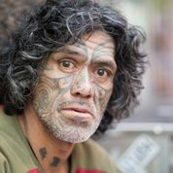

What can we anticipate in this “new” new zealand
25% of the population will be aged over 65 years of age
75% of the population will live in the top half of the North Island, 40% in Auckland
Asians will comprise 20% of the population – as will Māori
28% of the population will be immigrants (more like 35-45% of the working population) and 45% in Auckland
There will be 6 million of us in New Zealand, 1.5 million living overseas.

Slide 28
Next Meeting (s)
  Friday March 8th, 2024 – Dr Sarah Gordon – From psychiatric patient to Associate Professor (and psychiatric patient)
  Friday April 12th, 2024 - Dr Jonathan Warren – Is anaesthesia now safer than Boeing?
  Friday May 10th, 2024 – Max Rashbrooke – Title TBC – NZ Based writer on democracy and economic inequality

